Slide 1
Parallel Computer Architectures
High Performance Computing
SMPs, Past and Present

Slide 2
Contents
Historical development
SMPs
DSMs
Multithreading
Multicore

Slide 3
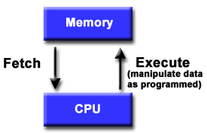
Traditional Sequential Hardware
First machines constructed as von Neumann architecture
CPU with control unit and arithmetic-logical unit (ALU)
Instruction registers and data registers for fast access by CPU
Bus between main memory and CPU was usually bottleneck in performance

Slide 4
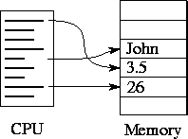
Sequential Machine Model
von Neumann machine
CPU executes a stored program that specifies a sequence of reads/writes to memory.
Model for 40 + years

Slide 5
Sequential Hardware
Modern von Neumann (sequential) architectures have additional features
One or more levels of cache between main memory and registers to cope with that bottleneck
Vector or SIMD units as accelerators
Multiple independent functional units (internal instruction-level parallelism, ILP)
Parallelism is exploited by compiler (and hardware), transparent for application programmers

Slide 6
Need for Speed
Parallelism introduced in order to increase machine power, perform more complex applications
2-d modeling replaced by 3-d models
Complete systems e.g. automobiles modeled
More accurate weather forecasts, longer range forecasts
Faster drug design beats competition to market
Supercomputing, High Performance Computing

Slide 7
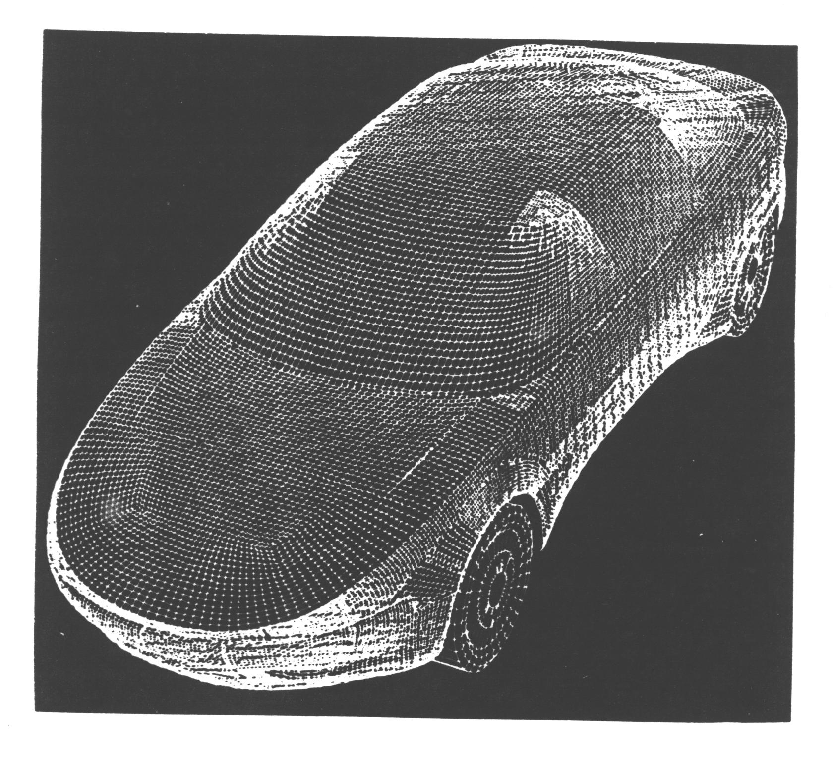
Realistic Computational Model
Benefits:
More accurate simulation
Real object behaves more like model
Reduces need to build prototype

Slide 8
Early Supercomputers
Vector supercomputers (e.g. from Cray Research)
Single CPU but instructions are pipelined: same operation is performed on whole sequence of data (operands)
Some special vector instructions e.g. multiply-add
High overhead in setting up pipeline, so only worthwhile if there is long chain of operands
Vector half-length is number of operands needed to achieve half the peak performance

Slide 9
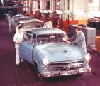
Vector Computations
Fortran loop :
  DO 100 I = 1, 100
  C ( I ) = A ( I ) + B ( I )
  END DO
Fortran 90 array operations express vectors :
C (1 : 100 ) = A ( 1 : 100 ) + B ( 1 : 100 )
These do not have same meaning!

Slide 10
Vector Computations
Once pipeline is set up for
C (1 : 100 ) = A ( 1 : 100 ) + B ( 1 : 100 )
the following can simultaneously occur :
Fetch floating point data A( 30 ), B ( 30 )
Compare exponents of A ( 29 ) , B ( 29 )
Shift A ( 28 )
Add A ( 27 ), B ( 27 )
Normalize result of adding A ( 26 ) and B ( 26 )
Store previous result in C ( 25 )

Slide 11
Multiple Memory Units
Memory organized in multiple units, memory banks
Access to these (loads and stores) possible simultaneously
Application developers must take care that operands are in different memory banks
Then, e.g. A ( I ) and B ( I ) can be fetched simultaneously, and A ( I + 5 ) stored at same time

Slide 12
Use of Vector Machines
Very expensive number crunchers
In 1980’s, no other machines were powerful enough for many important applications (e.g. aerospace, automotive)
Installed at central facilities. Users paid large sums for machine time. Access via batch systems.
Application developers skilled at rewriting code to get long vectors; cost minimized by getting code to run fast.

Slide 13

SIMD Architectures
Lock-step parallel computers, developed as alternative to vector computers
Front end (control unit) and back end (SIMD system)
Sequential instructions performed by front end
Parallel instructions broadcast to back end at each instruction cycle
“Massive parallelism”: maybe thousands of processors
Examples: Connection machines, MasPar
SIMD: Single Instruction Multiple Data

Slide 14
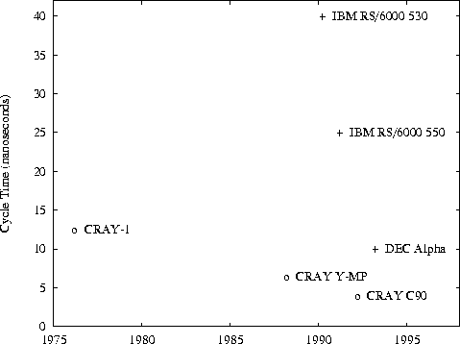
Trends in Clock Cycle Time
o = vector supercomputers, + = RISC microprocessors.
Both appeared to be approaching physical limits in early nineties
The answer? More performance via multiple CPUs

Slide 15
Shared Memory Architectures
Early systems built during the 1980s
Multiple processors access same main memory
Variety of memory (including cache) organizations attempted
Some systems had “symmetric” shared memory
  All processors have same cost of access to memory location
Some had non-uniform memory access costs
NUMA = non-uniform memory access

Slide 16
Basic Shared Memory Architecture
Multiple processors, all connected to a large shared memory
  Where are caches? How are processors connected to memory?
P1
P2
Pn
interconnect
memory

Slide 17
Shared Memory Architectures
Straightforward design provides uniform memory access and cache coherency
SMP originally stood for these computers only
Local cache connected to main memory via bus
When a memory location is updated, copies in local cache of other processors must be invalidated
Bus is bottleneck; limits size of systems possible
Several modest-sized architectures of this kind during 1980s

Slide 18
Shared Memory Architectures
Proved to be very useful architecture for server marketplace
Could execute many sequential applications concurrently, process many queries, …
Large amounts of memory, so very flexible with respect to workload
Potentially used for parallel jobs, but this was not the norm
The majority of parallel systems from 1980s on were SMPs used as servers

Slide 19
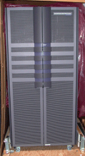
Sun E10000, Starfire
Widely used enterprise server of 1990s
Up to 64 processors and up to 64 GB shared memory
Some local cache per processor
A “real SMP”: Symmetrical multiprocessor (uniform memory access)
Full complement of sequential programming languages
Widely deployed in industry for variety of workloads

Slide 20

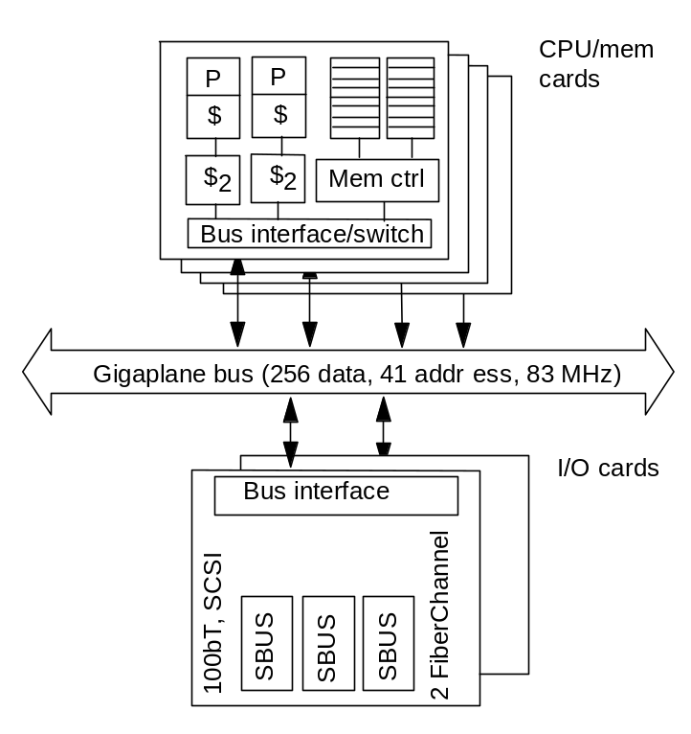
Engineering of SUN Enterprise
Proc + mem card - I/O card
  16 cards of either type
  All memory accessed over bus, so symmetric
  Higher bandwidth, higher latency bus

Slide 21
Shared Memory Architectures
But not so popular in High Performance Computing
Problem: impossible to build large machines of this kind that provided high performance for a parallel application
Each vendor had its own programming interface
Emphasized parallel execution of (Fortran) loops
Vendors did not survive, on the whole: Alliant, Encore, ….
But this led to some new ideas on building non-symmetric SMPs

Slide 22
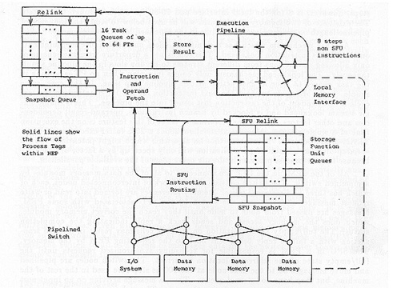
Denelcor HEP
Four Process Execution Modules (PEMs)
Each PEM has memory module, shares with others
Hardware support enabled threads to interact
Programmed with a slightly extended Fortran (concurrent subroutines and asynchronous variables)
8 built in all, first in 1982
Designers moved on to build Tera

Slide 23
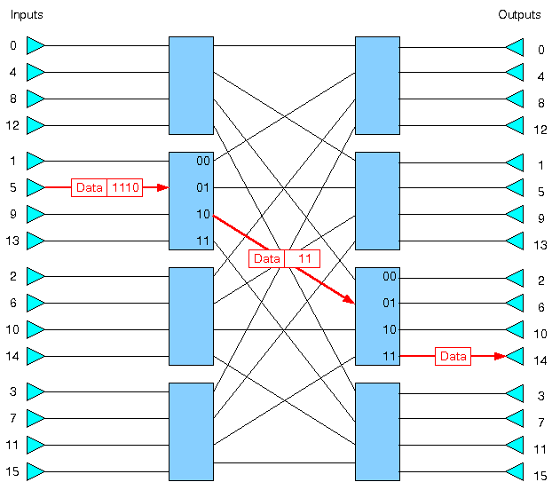
BBN Butterfly
Quite large system built during the 1980s
Up to 512 CPUs, each with some local memory
Every CPU able to access memory associated with other CPUs, so memory is shared
But big penalty for non-local access
About 15 times slower than local memory access
Named after the proprietary interconnect

Slide 24
Supercomputing Architectures
High Performance Computing needed a scalable architecture
Most easily provided by distributed memory computers (DMPs, AKA MPPs, clusters)
  A number of independent processors and memory connected via a network
  Custom and later off-the-shelf networks
Main problem is application development
  Standardization led to MPI
It is generally harder to write DMP applications than SMP applications

Slide 25
Distributed Memory Architecture
First built during late 1980’s and since then
Multiple compute “nodes”, each with its own memory
Nodes may be single processor machine, SMP or multicore
Nodes connected via network
Nodes do not share memory
If data in processor’s memory is needed by another processor, it must be transmitted via network
Data exchange slow in comparison to clock speed

Slide 26
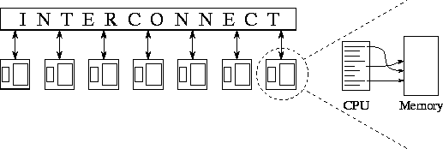
Distributed Memory Parallel Machines (Multicomputers)
Each node is complete system: Today, a node is often an SMP
Cost of “local” memory access << “remote” memory access
Variety of interconnects used (butterfly networks, hypercubes, multistage networks)

Slide 27
Parallel Architectures
Distributed Memory Machine (DMP)
Shared Memory Machine (SMP)
DMP Multicomputer Architecture
SMP Multiprocessor Architecture
Processor
Processor
Processor
P
C
P
C
P
C
•••••••••••••
M
M
M
Bus or Switch Network
Shared Memory
Network for Data Exchange

Slide 28
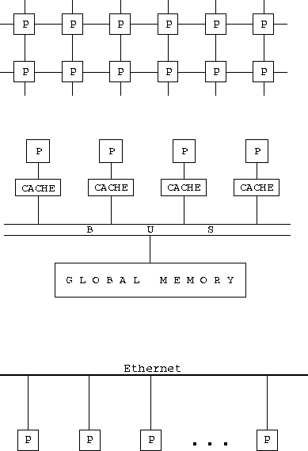
Distributed Memory Systems
(variety of interconnect designs)
Shared Memory Systems
Cluster, LAN

Slide 29
Interconnection Networks
Limited and exhaustive interconnections
2- and 3-dimensional meshes
Hypercube (not now common)
Using Switches:
  Crossbar
  Trees
  Multistage interconnection networks
1.<number>

Slide 30
Two-dimensional array (mesh)
Computer/
Links
processor
Also three-dimensional - used in some large high performance systems.
1.<number>

Slide 31
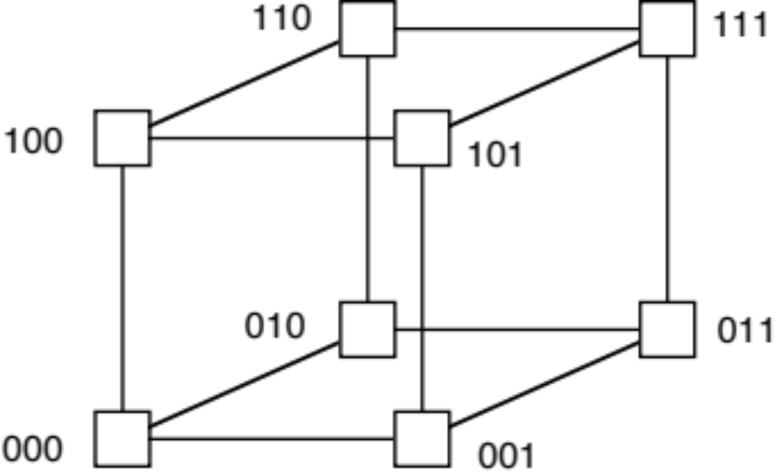
Three-dimensional hypercube
1.<number>

Slide 32
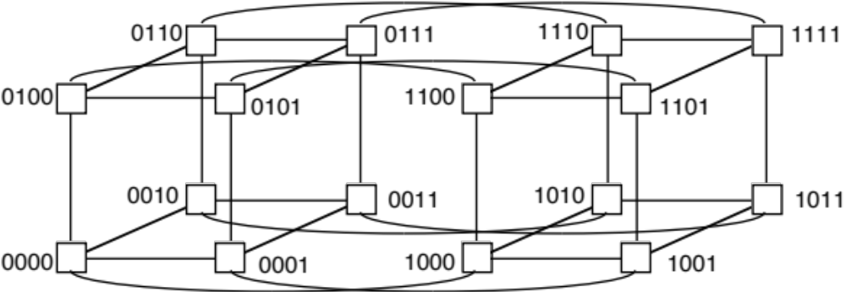
Four-dimensional hypercube
Hypercubes popular in 1980’s - not now
1.<number>

Slide 33
Crossbar switch
Memor
ies
Processors
Switches
1.<number>

Slide 34
Tree
Root
Links
Switch
element
Processors
1.<number>

Slide 35
Multistage Interconnection Network
Example: Omega network
2
´
2 switch elements
(straight-through or
crossover connections)
000
000
001
001
010
010
011
011
Inputs
Outputs
100
100
101
101
110
110
111
111
1.<number>

Slide 36
Shared Memory
All processes/threads access same shared memory data space
Shared memory space
proc1
proc2
proc3
procN

Slide 37
More Realistic View of Shared Memory Architecture
For small numbers of processors
Shared memory
cache1
cache2
cache3
cacheN
proc1
proc2
proc3
procN

Slide 38
Distributed Memory
The alternative model to shared memory
mem1
mem2
mem3
memN
proc1
proc2
proc3
procN
network

Slide 39
Distributed Shared Memory Systems
Design overcomes some limits of bus-based shared memory systems
Distributed memory, but memory is globally addressed
So looks like shared memory system
Hardware supports cache coherency
Examples: HP Exemplar, SGI Origin, Altix
Program as shared memory system

Slide 40
Distributed Shared Memory
For larger numbers of processors
mem1
mem2
mem3
memN
cache1
cache2
cache3
cache4
proc1
proc2
proc3
procN

Slide 41
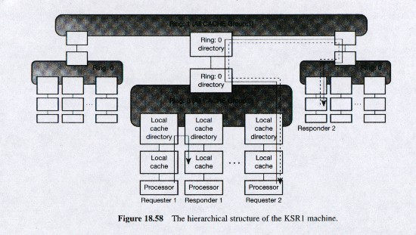
KSR 1 and 2 “Allcache”
Processors connected in hierarchical ring
“Cache” memory physically distributed, automatically routed to destination if not local
Cache coherent, copies of data may exist
6.7μs latency on 32-CPU ring
Built early 1990s KSR1: up to 1088 CPUs
KSR2: up to 5000 CPUs

Slide 42

Large-Scale DSM
Distributed
Shared Memory
SGI’s Origin and Altix series
Some of world’s largest machines
Cache-coherent across system
Takes about twice as long to access non-local data

Slide 43
Recent Shared Memory Architectures
SMPs introduced for desktop computing during late 1990s by major vendors (HP, Sun, Intel, IBM, …)
Cost-effective way to provide higher levels of performance
Intended for mainstream market, general-purpose applications
Mostly two or four CPUs that access same main memory, with local cache and cache coherency
A few bigger systems e.g. Sun’s 6400 series with up to 144 CPUs

Slide 44
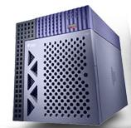
Sun E450 SMP
4 UltraSPARC processors (400-480MHz)
6KB Dcache, 16kB Icache per processor
4GB main memory in 4 banks
4-8MB cache per processor

Slide 45
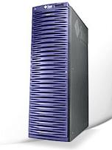
Sun Fire 6800 Server (V1)
Up to 24 UltraSPARC III processors in SMP architecture
192GB memory
9.6GB bandwidth
4-way associative on-chip 64KB data and 32KB instruction cache
8MB E-cache

Slide 46
Recent Shared Memory Architectures
Variety of applications parallelized for deployment on desktop SMPs
From databases applications to engineering codes
Vendors got together to define a portable high-level programming model, OpenMP
Independent threads, generally one per processor, cooperate to perform computation
But how to parallelize many widely used applications, e.g. MS WORD?

Slide 47
Fast Forward to Today’s Shared Memory Architectures
In last few years, we have witnessed introduction of multicore and multithreading computers
Already, all of our PCs and laptops are multicore and possibly also multhreading
Multicore processors replicate substantial portions of a CPU
  Each core can independently execute a stream of instructions (a “thread”)
  The threads share memory
  So they are shared memory parallel machines

Slide 48


The Memory “Wall”
Growing disparity between memory access times and CPU speed
Cache size increases show diminishing returns
Multithreading introduced to overcome delays while waiting for data
(This is NOT multicore)
Notes:
Provide more memory bandwidth
Increase aggregate DRAM bandwidth per gigabyte
Increase the bandwidth of the chip pins
Use multithreaded cores to tolerate memory latency
When latency increases, just increase the number of threads
Significantly, this does not change the programming model
Use caches to improve bandwidth as well as latency
Make it easier for compilers to optimize locality
Keep cache lines short
Avoid mis-speculation in all its forms
Parallel computing is necessary for memory balance
We can build bigger caches from plentiful transistors
Does this suffice, or is there a problem scaling up?
To deliver twice the performance with the same aggregate DRAM bandwidth, the cache miss rate must be cut in half

Slide 49
Processor-DRAM Gap (latency)
1000
µProc
60%/yr.
CPU
“Moore’s Law”
100
Processor-Memory
Performance Gap:
(grows 50% / year)
Performance
10
DRAM
7%/yr.
DRAM
1
1980
1981
1982
1983
1984
1985
1986
1987
1988
1989
1990
1991
1992
1993
1994
1995
1996
1997
1998
1999
2000
Time
Notes:
CS267 Lecture 2
Y-axis is performance
X-axis is time
Latency
Note that x86 didn’t have cache on chip until 1989

Slide 50
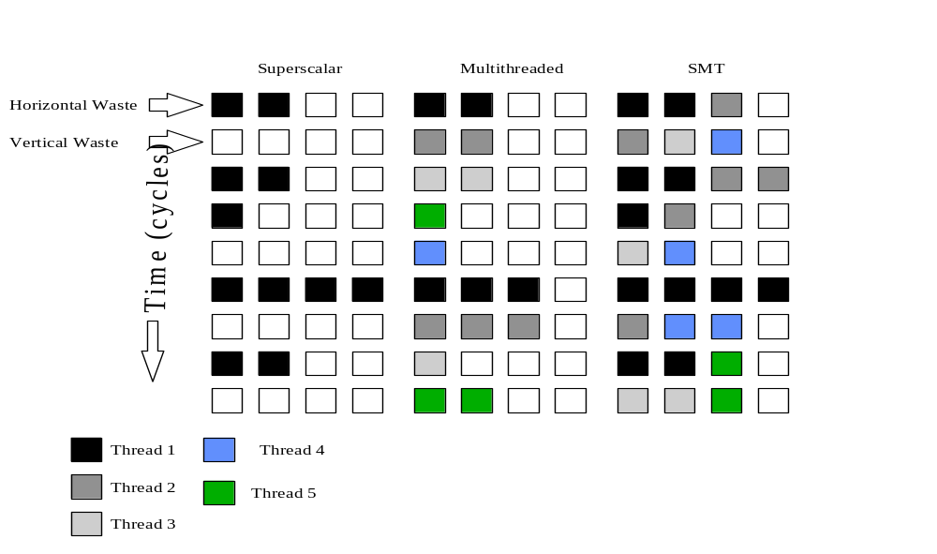
Multithreading
Make better use of on-chip functional units by allowing multiple instruction streams:
Interleaved multithreading
Simultaneous multithreading
Four functional units:
Colored: busy
See http://arstechnica.com/articles/paedia/cpu/hyperthreading.ars/
Notes:
if your multiprocessor is fully used but too hot, scale down voltage and frequency rather than processors
There are two ways to scale speed by a factor σ:
Scale the number of (running) cores by σ
Power will scale by the same factor σ
Scale the clock frequency f and voltage V by σ
Dynamic power will scale by σ³ (CV²f )
Static power will scale by σ (Vi_{leakage})
Total power lies somewhere in between
Clock scaling is worse when σ > 1
This is part of the reason times are changing!
Clock scaling is better when σ < 1
Moral: if your multiprocessor is fully used but too hot, scale down voltage and frequency rather than processors
Parallel computing is necessary to save power

Slide 51
Superscalar, Multithreading and SMT (Hyperthreading)

Slide 52
Multithreading: Basic Idea
Processor stalls due to cache miss, branch misprediction or data dependence are common
While one thread (instruction stream) is waiting, another thread may continue to work
Or two threads that access different functional units might both be active simultaneously
Requires that hardware can store multiple states, one per hardware thread
  Usually means a set of registers and a program counter per thread
  Lighter-weight implementations are possible
Transparent for programmer

Slide 53
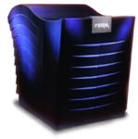
A large-scale multithreading pioneer:
Tera Multithreaded Architecture
Tera was bought by Cray Research
Only two systems built

Slide 54
Tera MTA
Each MTA processor has up to 128 RISC-like virtual processors.
Each virtual processor is a hardware stream with its own instruction counter, register set, stream status word and target and trap registers.
A different hardware stream is activated every clock period.
Each processor can access arbitrary locations in uniform shared memory at up to 2.5 gigabytes per second via interconnection network.
About 25 active streams per MTA processor are needed to overlap memory latency with computational processing.

Slide 55
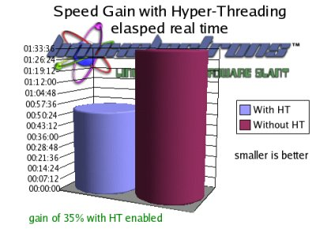
Intel’s Hyperthreading
Variant of simultaneous multithreading
For higher system throughput, more efficient use of processor
Two instruction streams (threads) per processor
Intel Xeon, then Pentium
Can be switched off
Used, abandoned, reintroduced

Slide 56

Hardware Trends
Power dissipation a major problem
Want to avoid the heat wave? Go multicore!
More and simpler processors, not higher Hz
Processors incomplete since share some resources: cores
Accelerators also developed for low power high performance on suitable operations
Notes:
if your multiprocessor is fully used but too hot, scale down voltage and frequency rather than processors
There are two ways to scale speed by a factor σ:
Scale the number of (running) cores by σ
Power will scale by the same factor σ
Scale the clock frequency f and voltage V by σ
Dynamic power will scale by σ³ (CV²f )
Static power will scale by σ (Vi_{leakage})
Total power lies somewhere in between
Clock scaling is worse when σ > 1
This is part of the reason times are changing!
Clock scaling is better when σ < 1
Moral: if your multiprocessor is fully used but too hot, scale down voltage and frequency rather than processors
Parallel computing is necessary to save power

Slide 57
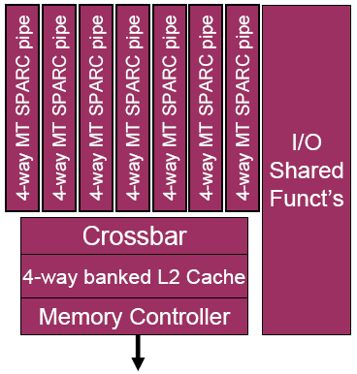
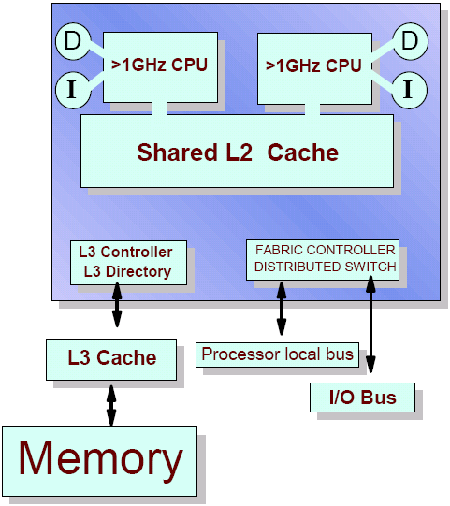

So Now We have Multicore
Sun T-1 (Niagara), 2005
Intel rocks the boat 2005
IBM Power4, 2001
Small number of cores, shared memory
Some systems have multithreaded cores
Trend to simplicity in cores (e.g. no branch prediction)
Multiple threads share resources (L2 cache, maybe FP units)
Deployment in embedded market as well as other sectors
Notes:
Uniprocessor performance is leveling off
Instruction-level parallelism is near its limit (the ILP Wall)
Power per chip is getting painfully high (the Power Wall)
Caches show diminishing returns (the Memory Wall)
Meanwhile, logic cost ($ per gate-Hz) continues to fall
How are we going to use all that hardware?

Slide 58
CPU Memory Hierarchy
Core 1
Core 2
Increasing number pf levels of cache
Some may be shared by more than one core
Cores share bandwidth to main memory
This makes memory bottleneck even worse!
Registers
Registers
L1 Dcache
L1 Dcache
Small, 4MB
Very small
L2 cache
DDR2 RAM

Slide 59
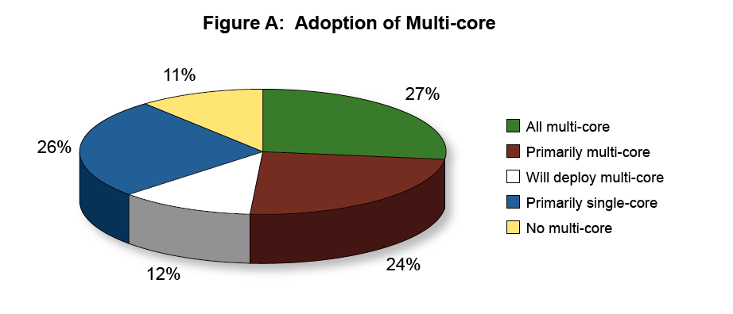
Take-Up in Enterprise Server Market
Increase in volume of users
Increase in data, number of transactions
Need to increase performance
Survey data
Notes:
First choose a programming model which minimizes the need for coherence
Many-core systems should not attempt to implement fine grain coherence across all memory
Memory needs only to be coherent at certain points and then only those parts which are being shared
This ought to be reflected in the programming model if at all possible
Bus ‘snooping’ and/or global broadcast is probably not going to be an extensible solution
A bigger issue is support for fine-grain parallelism
Thread granularity depends on the amount of state per thread and on how much it costs to swap it when the thread blocks
Another is whether all processors should look the same
There are options for heterogeneity
Heterogeneous architectures or heterogeneous implementations
Shared memory can be used to communicate among them
Homogeneous architectural data types will help performance
The biggest issue may be how to maintain system balance

Slide 60
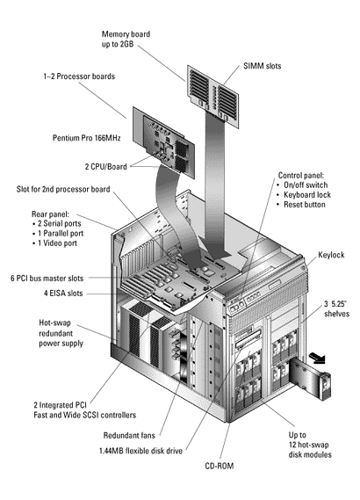
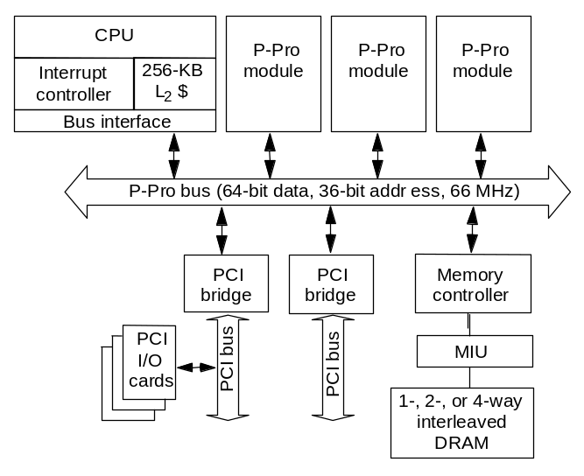
Intel Pentium Pro Quad
SMP for the masses:
All coherence and multiprocessing glue in processor module
Highly integrated, targeted at high volume
Low latency and bandwidth
01/26/2006

Slide 61
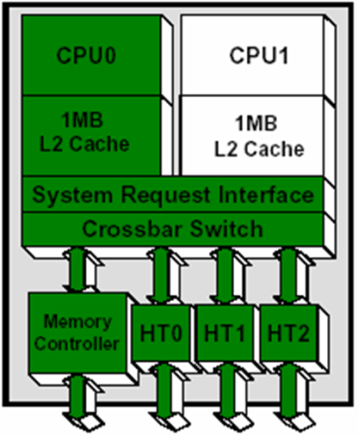
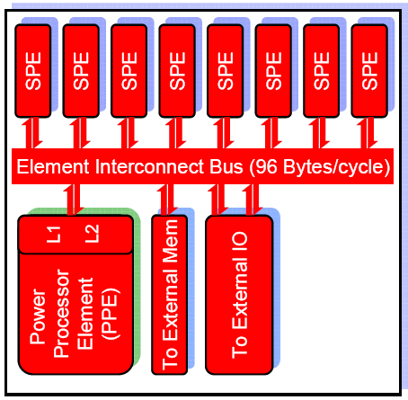
More Parallelism in Architecture
AMD Opteron
IBM Cell
Multicore, multithreaded processors
  2,4, 8-core today, but hundreds of cores in next 10 years
  Heterogeneous cores: graphics, networking,..
  Different degrees of shared/dedicated resources
  Energy-efficiency, virtualization…

Slide 62
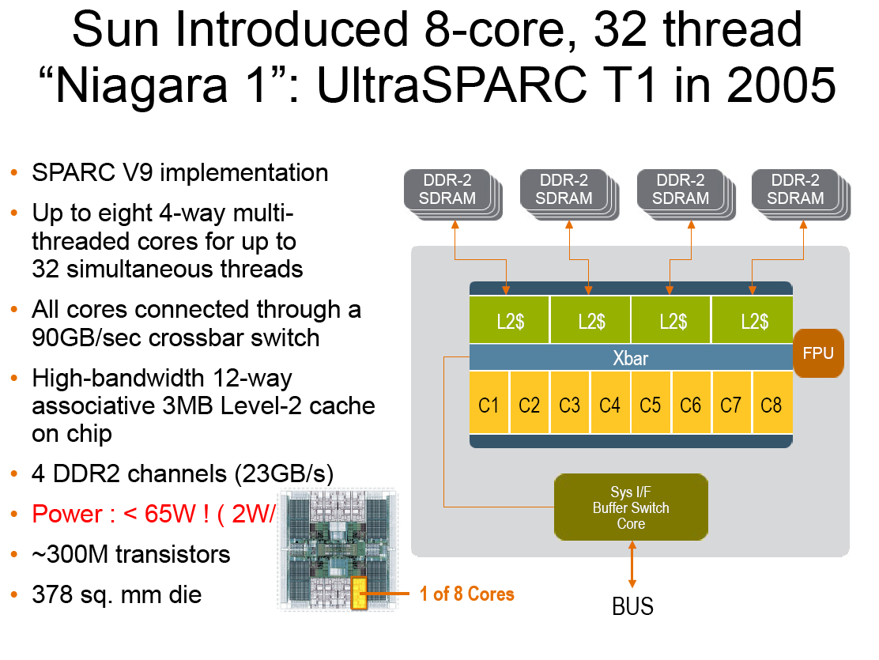

Slide 63
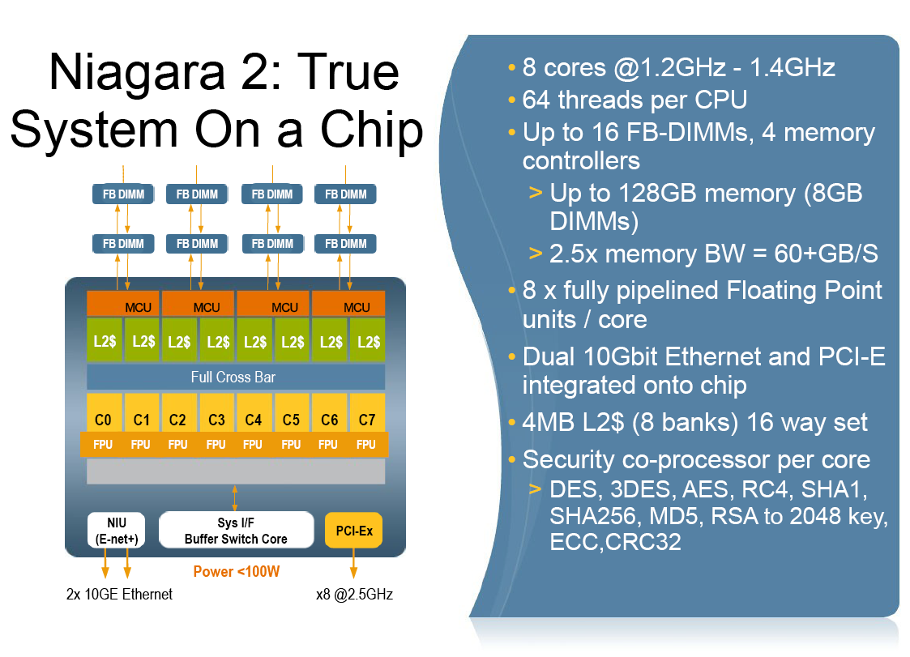


Slide 64
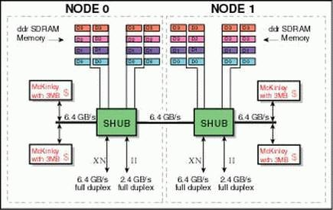
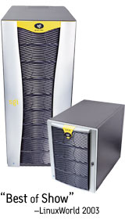
SGI Altix 3000
A node contains up to 4 Itanium 2 processors and 32GB of memory
Network is SGI’s NUMAlink, the NUMAflex interconnect technology.
Uses a mixture of snoopy and directory-based coherence
Up to 512 processors that are cache coherent (global address space is possible for larger machines)
Notes:
CS267 Lecture 2

Slide 65
The Memory Wall
Multithreading can help overcome minor delays.
But multicore, SMT reduces amount of cache per thread and introduces competition for bandwidth to memory
This is going to be a major headache for application developers
Although there may be potential for exploiting the sharing of some cache
Notes:
Provide more memory bandwidth
Increase aggregate DRAM bandwidth per gigabyte
Increase the bandwidth of the chip pins
Use multithreaded cores to tolerate memory latency
When latency increases, just increase the number of threads
Significantly, this does not change the programming model
Use caches to improve bandwidth as well as latency
Make it easier for compilers to optimize locality
Keep cache lines short
Avoid mis-speculation in all its forms
Parallel computing is necessary for memory balance
We can build bigger caches from plentiful transistors
Does this suffice, or is there a problem scaling up?
To deliver twice the performance with the same aggregate DRAM bandwidth, the cache miss rate must be cut in half

Slide 66
Manycore is Coming, Ready or Not
An Intel prediction: technology might support
2010: 16—64 cores 200GF—1 TF
2013: 64—256 cores 500GF– 4 TF
2016: 256--1024 cores 2 TF– 20 TF
More cores, more multithreading
More complexity in individual system
  Hierarchical parallelism (ILP, SMT, core)
  Accelerators, graphics units, FPGAs
Multistage networks for data movement and sync.?
Memory coherence?
Applications are long-lasting: A program written for multicore computers may need to run fast on manycore systems later
Notes:
BIG challenge is memory bandwidth!!!!
First choose a programming model which minimizes the need for coherence
Many-core systems should not attempt to implement fine grain coherence across all memory
Memory needs only to be coherent at certain points and then only those parts which are being shared
This ought to be reflected in the programming model if at all possible
Bus ‘snooping’ and/or global broadcast is probably not going to be an extensible solution
A bigger issue is support for fine-grain parallelism
Thread granularity depends on the amount of state per thread and on how much it costs to swap it when the thread blocks
Another is whether all processors should look the same
There are options for heterogeneity
Heterogeneous architectures or heterogeneous implementations
Shared memory can be used to communicate among them
Homogeneous architectural data types will help performance
The biggest issue may be how to maintain system balance

Slide 67
Recent Shared Memory Architectures
Single threaded performance is unlikely to increase much
Performance improvements will have to come from exploitation of parallelism
  Shared memory parallelism
So we are all going to have to learn to write shared memory programs
Experience has mostly been in parallelizing high performance computing applications
  But now we need to parallelize all apps

Slide 68
Revised Basic Shared Memory Architecture
One or more processor cores
System capable of executing multiple threads, independent instruction streams, concurrently
Memory is shared, but may be partitioned
  Where are caches?
  What is shared by threads?
P1
P2
Pn
interconnect
This is our original diagram:
memory

Slide 69
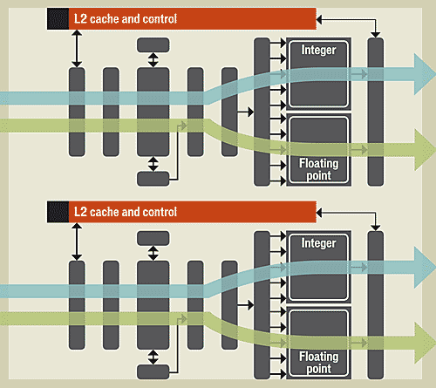
Revised Shared Memory Architecture
One or more threads per cores

Slide 70
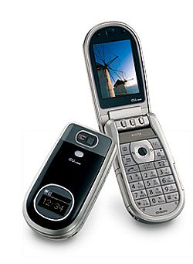

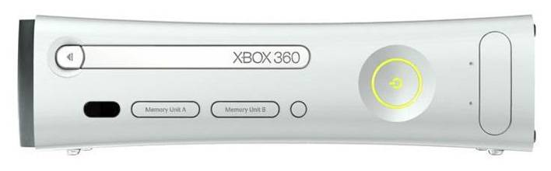
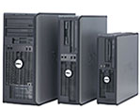

Where are SMPs Today?
Cell phones
Laptops
Consoles
Desktops

Slide 71
Reading Material
For overview of SMT, read article at
  http://arstechnica.com/articles/paedia/cpu/hyperthreading.ars
  Author “uses process and thread interchangeably”. Do NOT do this
  Calls interleaved multithreading “superthreading”

Slide 72
Summary
Shared memory parallelism now ubiquitous
Future machines will increase their power by increasing the number of threads they can handle simultaneously
  Multicore and multithreading
To benefit from additional power, programs will have to be (shared memory) parallel
This is a software revolution!

